Slide 1
Cluster of Brokers
August 8th 2016

Slide 2
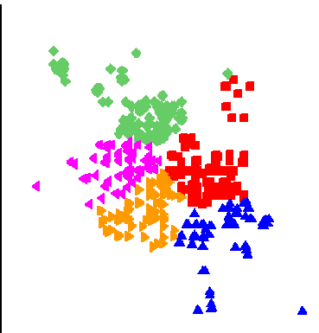
Background
Different days, distinct cluster of trade distribution.
Day 1
Day 2
Some brokers remained together!
Brokers were clustered by the number of days remained together.

Slide 3
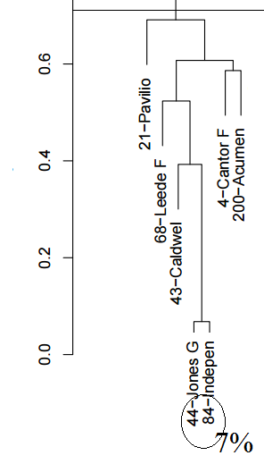
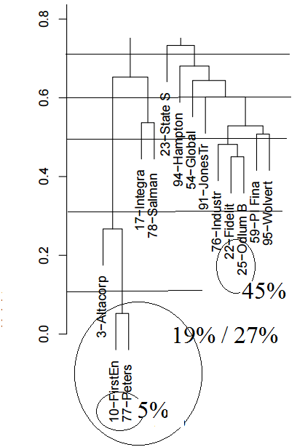
Clustered according to nb days together
Days in different clusters (%)
Days in different clusters (%)

Slide 4
Why were the brokers in the same cluster?
93% of period

Slide 5
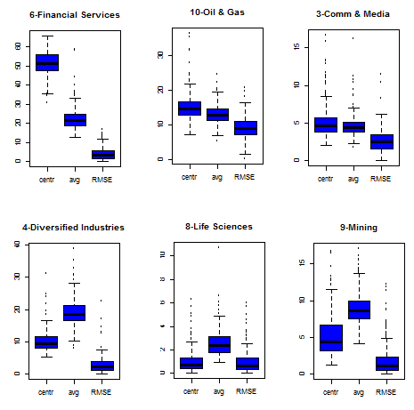
44 - Jones Gable & Company Ltd 84 - Independent Trading Group

Slide 6
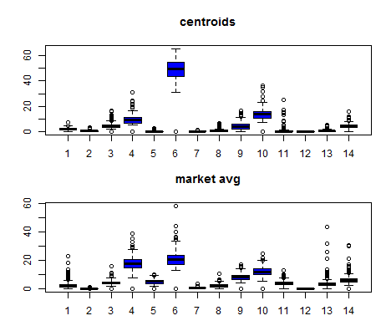
44 - Jones Gable & Company Ltd 84 - Independent Trading Group

Slide 7
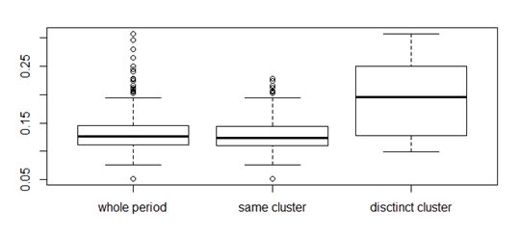
What happens when the brokers were in distinct clusters?
44 - Jones Gable & Company Ltd 84 - Independent Trading Group
RMSE (root mean square error)

Slide 8
Why are the brokers in the same cluster?
95% of period

Slide 9
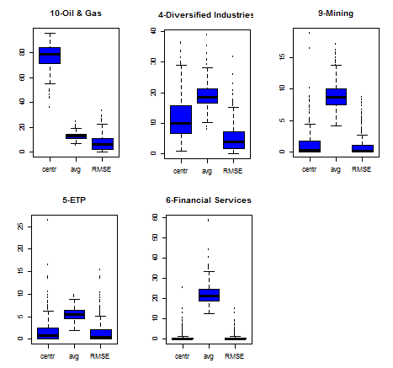
10 - FirstEnergy Capital Corp 77 - Peters & Co. Ltd

Slide 10
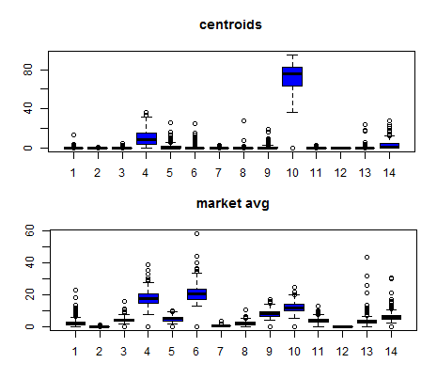
10 - FirstEnergy Capital Corp 77 - Peters & Co. Ltd

Slide 11
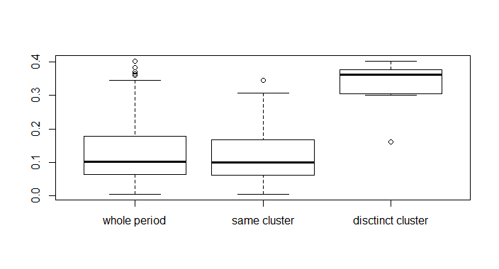
What happens when the brokers were in the distinct clusters?
10 - FirstEnergy Capital Corp
77 - Peters & Co. Ltd
RMSE (root mean square error)

Slide 12
Conclusion
For brokers in the same cluster:
The trade distribution by sector did not change so much along the period;
Their trades were concentrated in the same sectors;
The trade distributions were different when the brokers were not in the same cluster.
Next Steps:
Analyse the behavior of all brokers;
Try to make associations between them.

